Slide 1

Basics of Neural Network Programming
Gradient Descent
deeplearning.ai
Notes:
Until now we have studied logistic regression
Loss function
Cost function
We will learn gradient descent to train our parameters w.

Slide 2
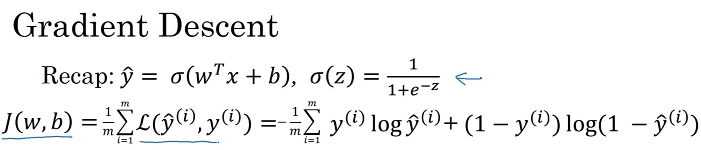
Gradient Descent – Recap
Notes:
Cost function is a function of parameters w & b
It is the average of loss function for all the training examples
Cost function measures how well the parameters are doing on a training set.
Loss function measures how our prediction compares to original value for an example. Therefore, it is natural that we want to find the best parameter values.

Slide 3
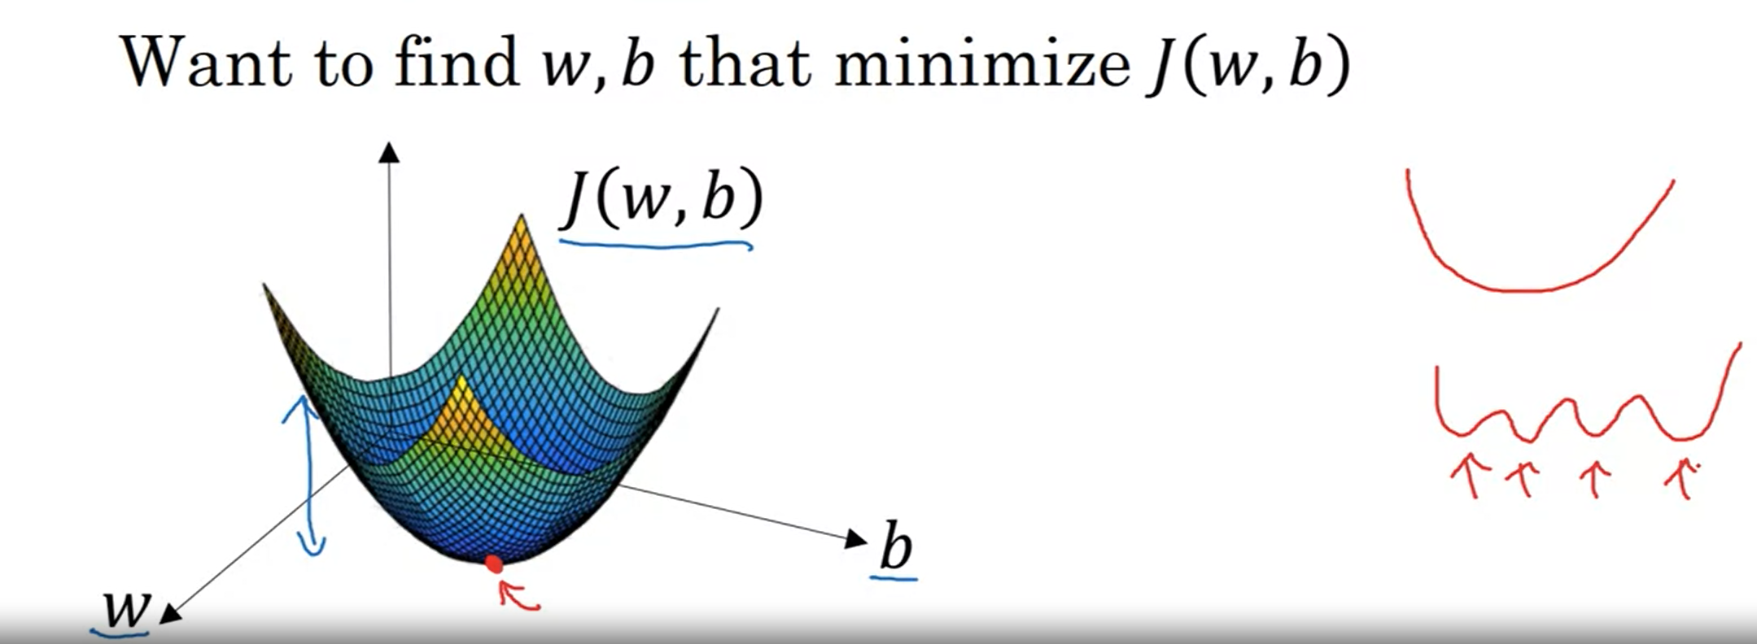
Gradient Descent – Illustration
Notes:
Illustration:
Horizontal axis represents parameters w & b (we illustrated q & b as real number)
Cost function is then some surface above these parameters, height represents the value of cost function at a certain point.
Now we want to find the value of this cost function at the red point which indicates the least value for cost function. It turns out that this is a convex function as shown in the drawing. Moreover, this is the reason(cost function as convex) that our cost function J is of the current type for logistic regression.

Slide 4
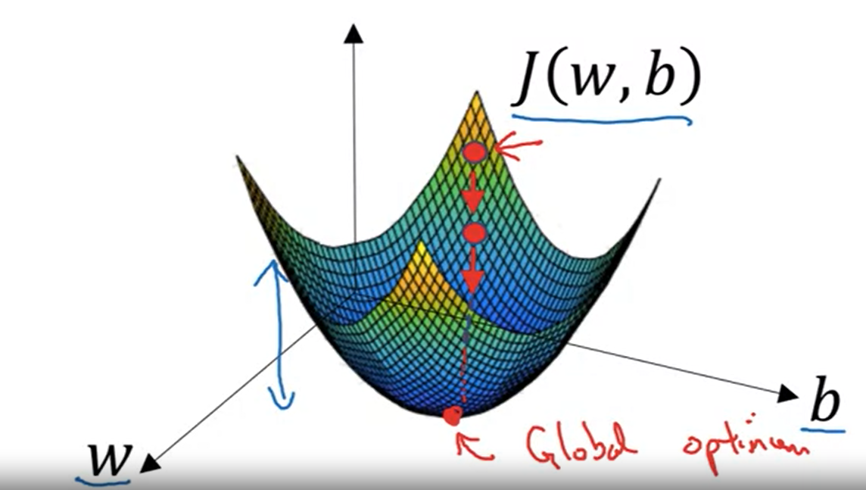
Gradient Descent – Finding Parameters
Notes:
To find the parameters, what we do is that we initialize the parameters to the red dot , some initial value.
Any initialize will work for logistic regression, zero or random.
Since the function is convex we should get to the lower red dot eventually.
For practical purposes, we take value between 0 & 1.
Gradient descent takes one step in the steepest direction. We can step there in one or multiple iterations to Global Optimum. It depends upon the learning rate.

Slide 5
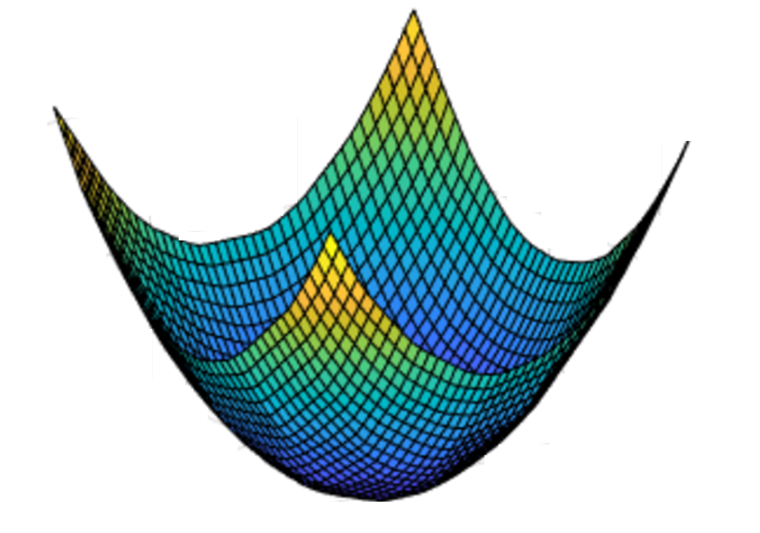
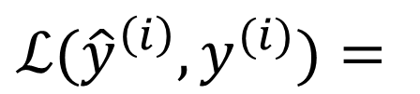

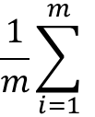
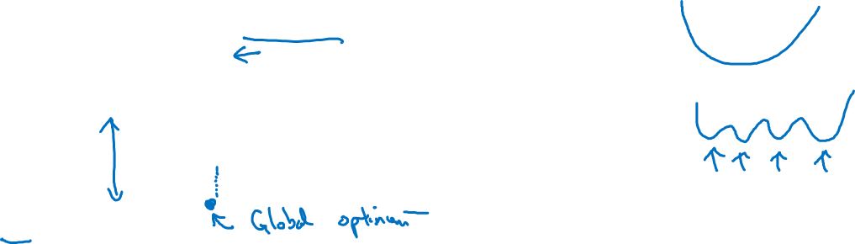

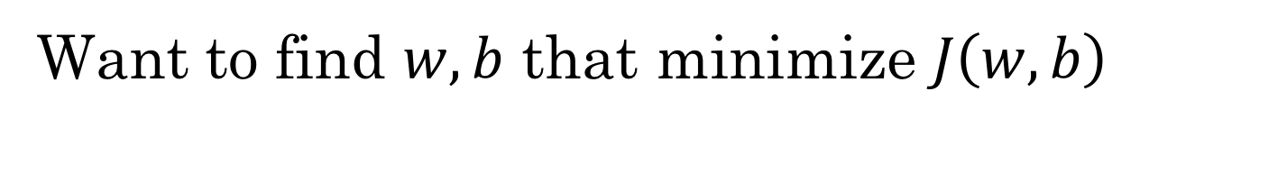
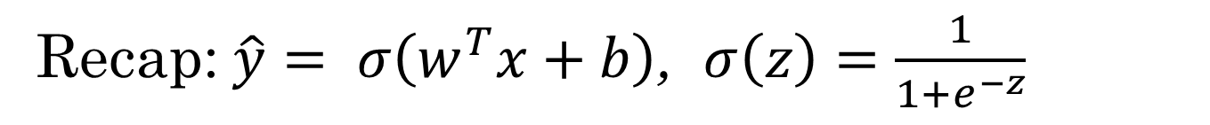

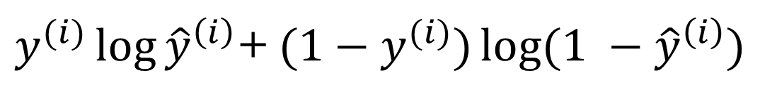
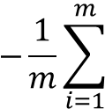

Gradient Descent – Bringing Together
Recap: $\hat{y}= σ\left(w^{T}x+b\right)$, $σ\left(z\right)=\frac{1}{1+e^{−z}}$
$$\frac{1}{m}\sum_{i=1}^{m}{ }$$
$ℒ({\hat{y}}^{\left(i\right)},y^{(i)})$ $=$
$$−\frac{1}{m}\sum_{i=1}^{m}{ }$$
$$J\left(w,b\right)=$$
$y^{(i)}\log{{\hat{y}}^{\left(i\right)}}$+ $({1−y}^{(i)})\log{(1 −{\hat{y}}^{\left(i\right)})}$
Want to find $w,b$ that minimize $J\left(w,b\right)$
$$J\left(w,b\right)$$
$$b$$
$$w$$

Slide 6
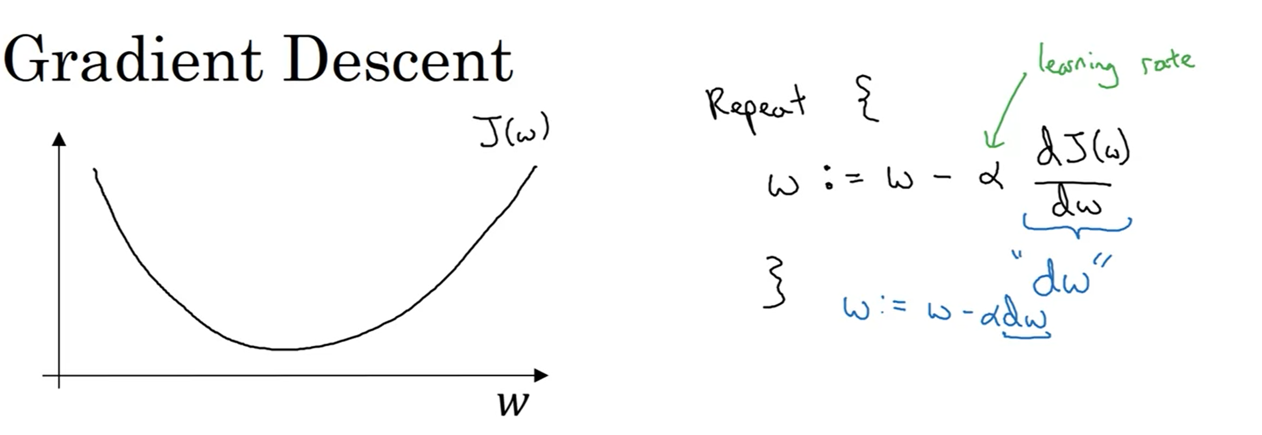
Gradient Descent – Working
Notes:
Lets say if we have a function J(w) which we want to minimize. For now, we are ignoring Bias to plot the graph in one dimension.(of weights)
What gradient descent does is :
It repeatedly updates the value of w using the formula in the slide.
Alpha is the learning rate, it tells us how drastically we should update the value of the weights. Later, we will discuss ways to choose, learning rate alpha.
The 2nd term with alpha is derivative of cost function with respect to weight. This value is the update or change that we want to make to the value of parameters w. In our code to implement gradient descent, we will use dw for this term.

Slide 7
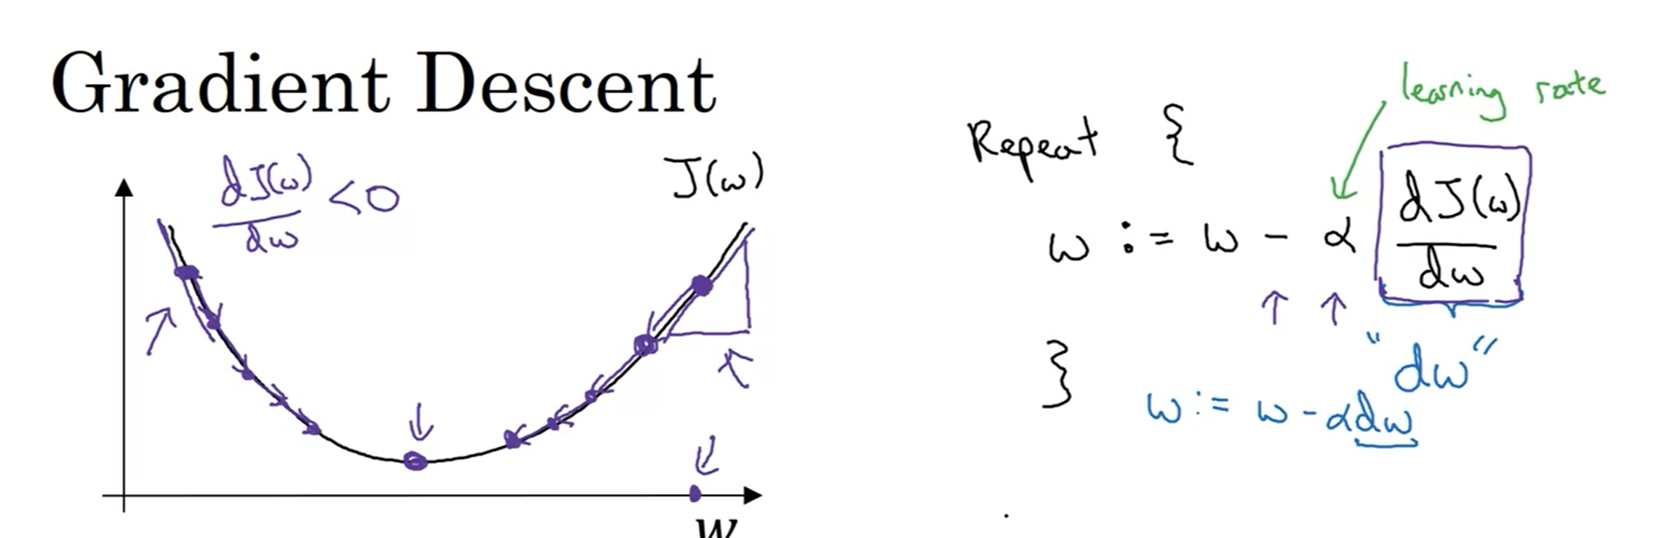
Gradient Descent – Making Sense
Notes:
Question: How does this change/update works, let us try to make sense of it.
Let us say that currently w is at first purple dot value on the right, with corresponding cost shown as purple dot on the curve.
Definition of Gradient : Slope of the function (height divided by length )
Now, at the start, when we take the derivative of the function it will be a positive value, slope M = y2-y1/x2-x1 & we read a line from left to right. As a result a positive value will get multiplied with alpha & the product gets separated from weight, decreasing the w from initial big value to a smaller value.
On the other hand, if our initialized weight value is smaller & we take the gradient of it, it will be negative, as a result a negative value when subtracted from w will actually increase the value of w. This will increase the weight of value to move towards the value of weight where the cost is lower.
Overall, this term with alpha tells us the direction & amount with which we should change.
Alpha tells us how much of this change should be made, for example if it is 1, it is saying yes, subtract this fully from the current value.
Knowing more about calculus help us understand more about neural networks.
https://math.stackexchange.com/questions/2456332/what-do-the-sign-and-the-value-of-a-slope-tell-us-regarding-the-nature-of-the-st
A slope determines how steep a line is and the sign indicates if it's going "uphill" or "downhill".
The lowest absolute slope (the absolute value of a slope) is 0 which means the line is perfectly horizontal. A very small slope, so 1/10 means it's slightly up hill. (And a slope of −1/10 means it's slightly downhill.)
A slope of 1 means it rises just as fast as it goes forward. The slope is at a 45∘45∘ angle. (And a slope of −1−1 means it sinks just as fast as it goes forward). This is not a limit. You can have lines that are steeper.

Slide 8
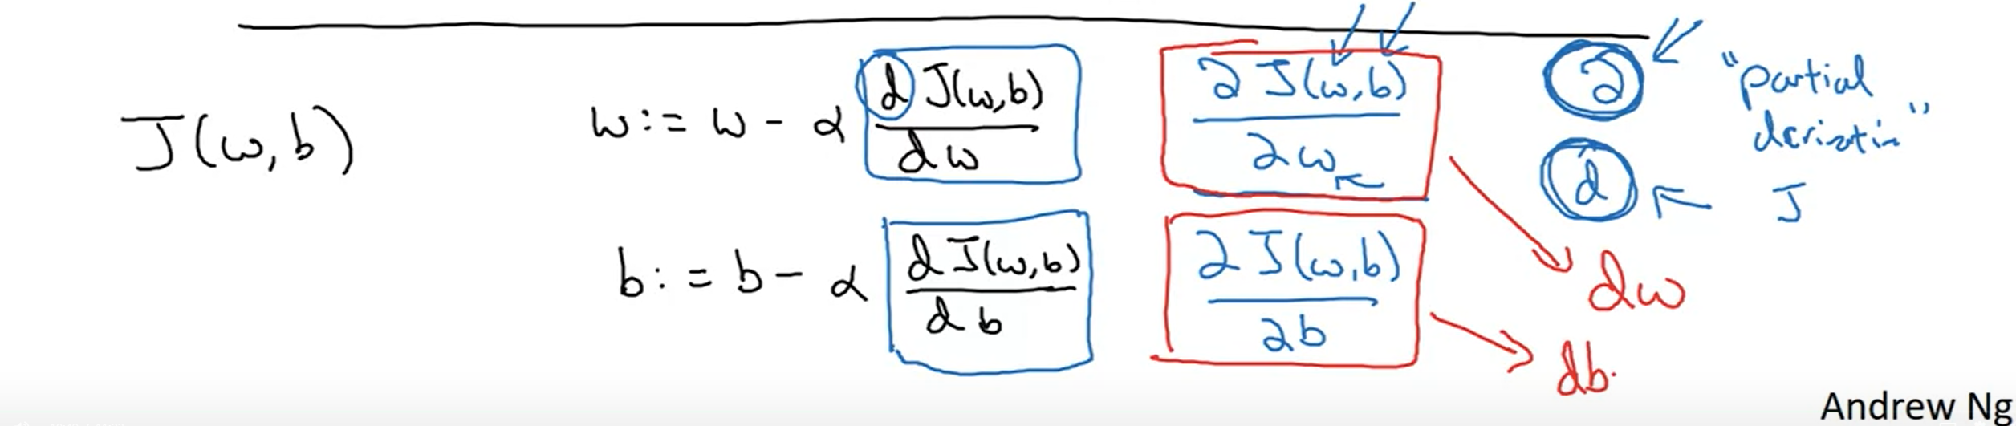
Gradient Descent – Derivative Notation.
Notes:
In our cost function, the actual update also has bias. The actual implementation is sometimes confusing.
The funny symbol is a fancy font of derivative. In English, it can be called ruu or row or whatever. This is called partial derivative function which we use in case when we have multiple variables 2 or more.
Partial derivative means that we are measuring the slope of the function with respect to one of the variables.
In our code notation, dw denotes the slope of cost with respect to weight variable & db denotes the slope of the cost function with respect to db.

Slide 9

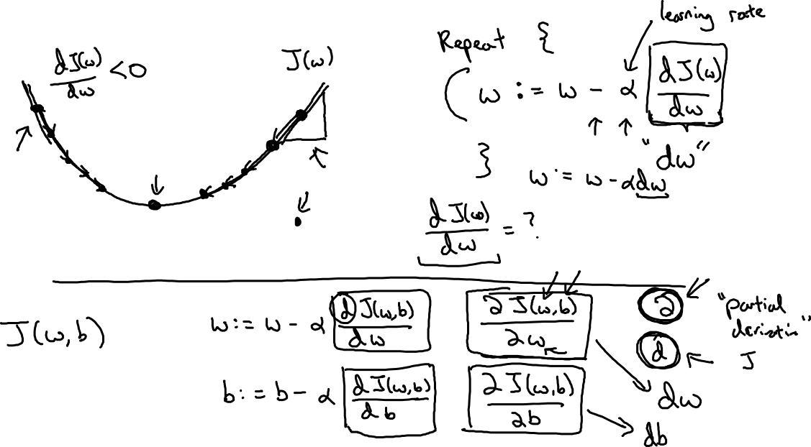
Gradient Descent
$$w$$

